Slide 1
CSC741 Digital Image Processing Presentation 9
Jessica Gallo & Alex Liew

Slide 2
Assignment
Jessica
1.(10 points) Implement histogram-based segmentation on your image. Identify the peaks of your histogram with the "objects" that they correspond to. Show your image, its histogram, the ranges, etc. Show the identified objects.
2.(10 points) Implement a global thresholding algorithm and experiment on images with a) two major modes b) three significant modes and observe the results using different initial estimates of T. Discuss your findings.
3.(30 points) Implement multilevel and adaptive thresholding algorithms and experiment on images and observe the results using different T's initial estimates.
Bonus and for team
(20 points) Implement mean histogram stretching for image enhancement and segmentation
(20 points) Implement adaptive gaussian thresholding algorithm
Alex
4.(50 points) Implement Niblack's and Sauvola'sthresholding algorithms on gray and color images

Slide 3
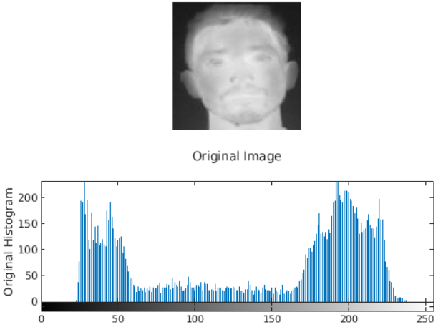
Histogram Segmentation
Peak
Peak
Background
Face

Slide 4
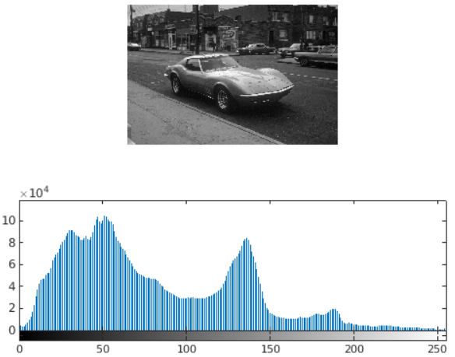
Histogram Segmentation (3 peaks)
Peak
Peak
Peak
Buildings
Car
Sidewalk

Slide 5
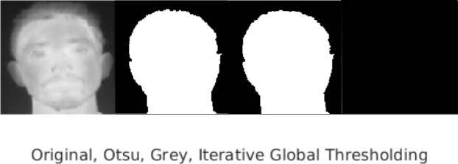
Global Thresholding with 2 Major Modes
T = 1

Slide 6
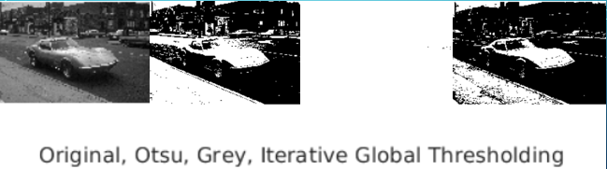
Global Thresholding with 3 Modes

Slide 7

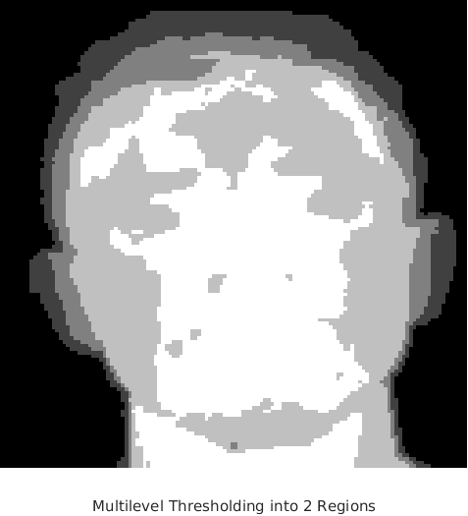
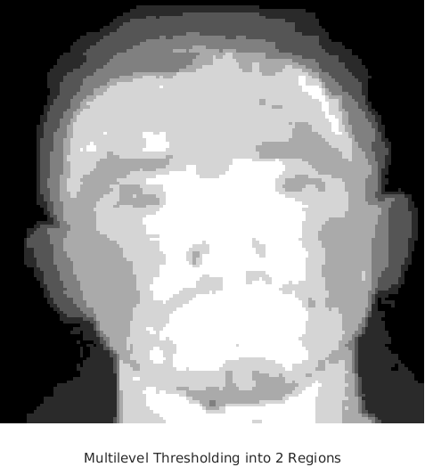
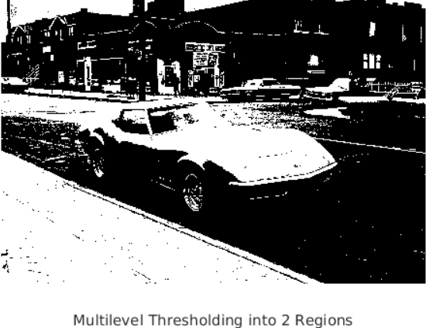
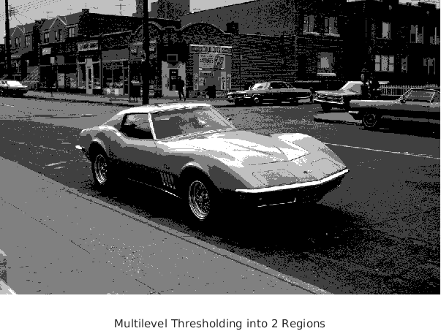
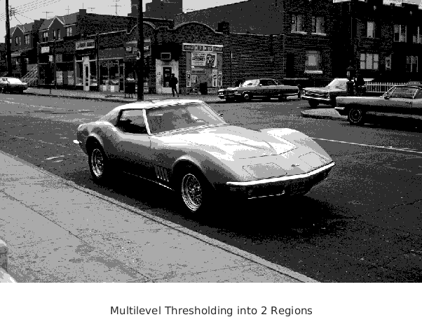
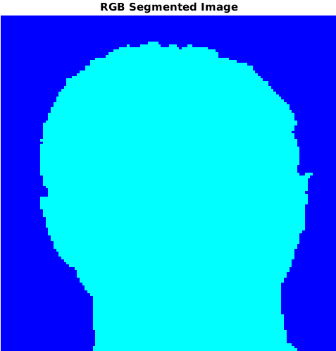
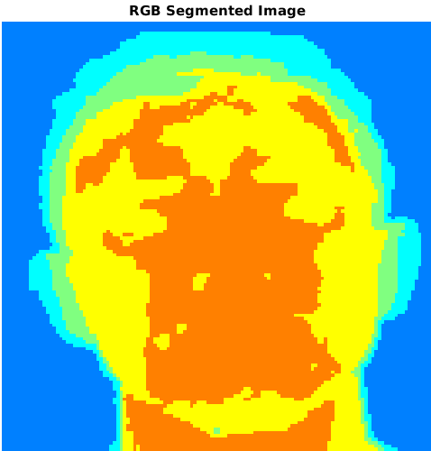
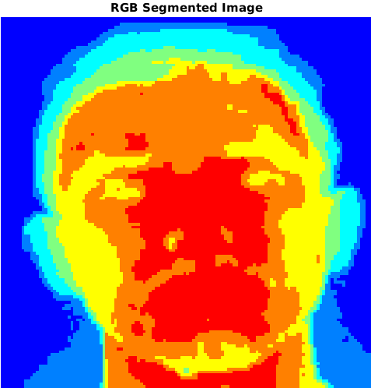
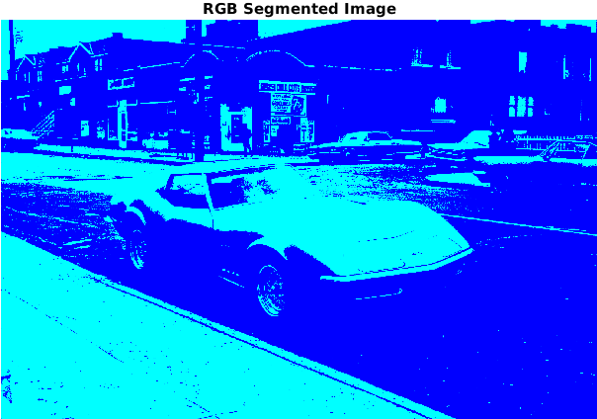
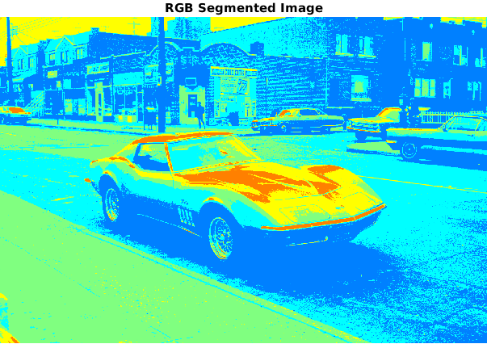
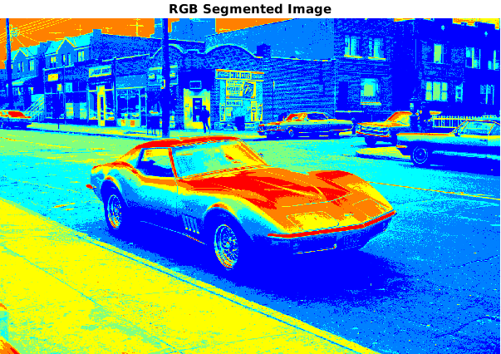
Multi-Level Thresholding Algorithms
T = 1
T = 4
T = 6
T = 1
T = 4
T = 6

Slide 8
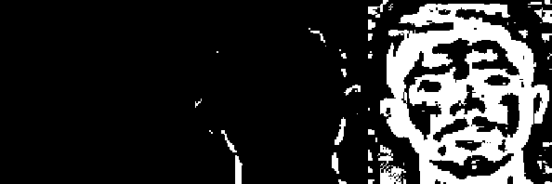
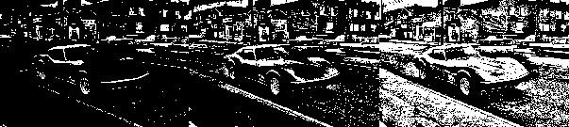
Adaptive Thresholding Algorithms
T = 1
T = 4
T = 6

Slide 9
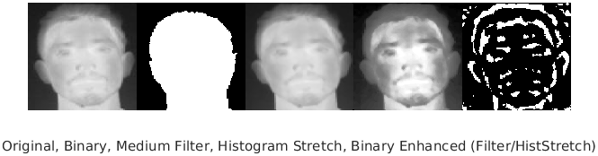
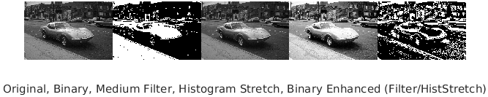
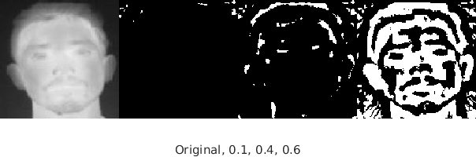
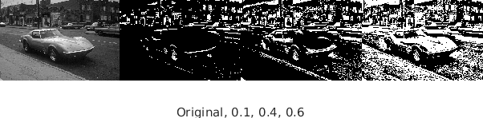
Mean Histogram Stretching for Image Enhancement and Segmentation
0.5
0.5
0.1
0.4
0.6
0.1
0.4
0.6

Slide 10


Adaptive Gaussian Thresholding Algorithm

Slide 11

Conclusion
0.1
0.4
0.6
Multi-Level
Adaptive
Mean Histogram Stretching
Adaptive Gaussian

Slide 12
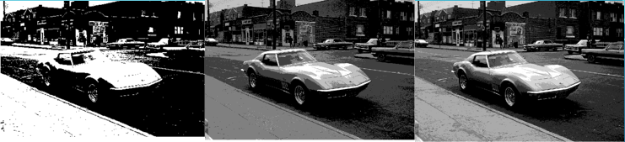
Conclusion
0.1
0.4
0.6
Multi-Level
Adaptive
Mean Histogram Stretching
Adaptive Gaussian

